Slide 1
8. Relational Database Design

Slide 2
University Relational Schema
Classroom (building, room number, capacity)
Department (dept name, building, budget)
Course (course_id, title, dept name, credits)
Instructor (i_ID, name, dept name, salary)
Section (course id, sec id, semester, year, building, room number, time slot id)
Teaches (i_ID, course id, sec id, semester, year)
Student (s_ID, name, dept name, tot cred)
Takes (ID, course id, sec id, semester, year, grade)
Advisor (s_ID, i_ID)
time slot (time slot id, day, start time, end time)
Prereq (course id, prereq id)

Slide 3
Goal
To generate a set of relation schemas, that allows us to
Store information without unnecessary redundancy, yet
Also allows us to retrieve information easily
To design schemas in an appropriate normal form
Need information of real-world enterprise information
Some of this information exists in a well-designed E-R diagram, but additional information about the enterprise may be needed as well
Require formal approach to relational database design based on the notion of functional dependencies to define normal forms in terms of functional dependencies and other types of data dependencies

Slide 4
Logical Database Design
The process of deciding how to arrange the attributes of the entities in the business environment into database structures, such as the tables of a relational database
This consists of deciding which tables to create, what columns they will contain, as well as the relationships between the tables
The goal is to create well structured tables that properly reflect the company’s business environment

Slide 5
Design Alternative: : Larger Schemas
Suppose instead of having two schemas instructor and department, have single schema: inst dept (ID, name, salary, dept name, building, budget)
Result of a natural join on the relations corresponding to instructor and department
Seems a good idea because some queries can be expressed using fewer joins
Need to repeat the department information (“building” and “budget”) once for each instructor in the department, as many instructors are available in the departments – creating problem of redundancy
If we forget the redundancy problem, and still continue with design there is still another problem
When creating a new department in the university
We cannot represent directly the information concerning a department unless that department has at least one instructor for newly created department
In the old design, the schema department can handle this

Slide 6
Design Alternative: : Smaller Schemas
A real-world database has
A large number of schemas, an even larger number of attributes and the number of tuples can be in the millions or higher
Real university requires that every department must have only one building and one budget value, so two schemas
Department (dept name, building, budget)
Instructor (i_ID, name, dept name, salary)

Slide 7
Design Alternative: : Smaller Schemas
Not all decompositions of schemas are helpful
Consider an extreme case where all schemas consisting of one attribute
No interesting relationships of any kind could be expressed
Consider a less extreme case
Decompose employee schema: employee (ID, name, street, city, salary)
Into two schemas:
employee1 (ID, name) employee2 (name, street, city, salary)

Slide 8
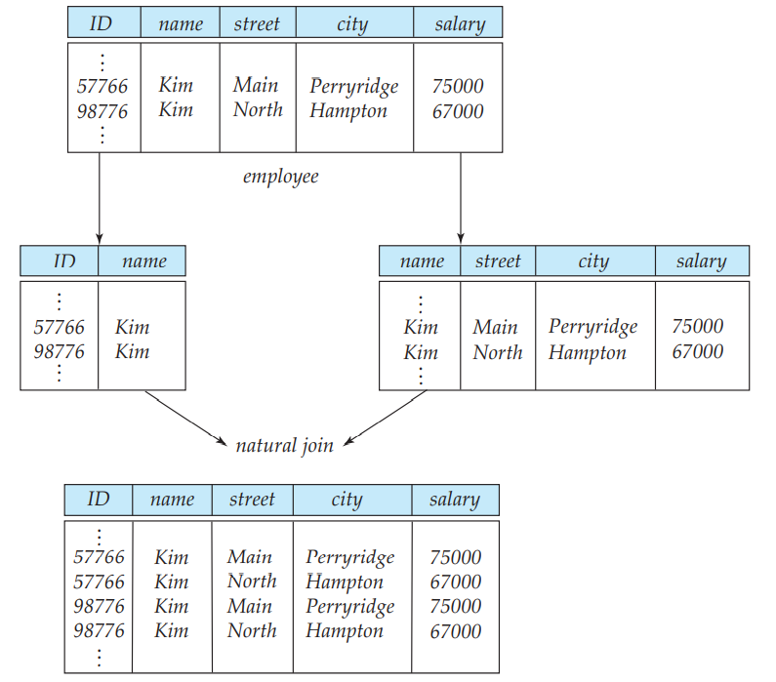
Design Alternative: : Smaller Schemas
If we attempt to regenerate the original tuples using a natural join
Although we have more tuples, we actually have less information
Unable to distinguish which of the Kims’
Decomposition is unable to represent certain important facts about the university employees
Need to avoid such decompositions
Such decompositions known as lossy decompositions
Opposite to this are known as lossless decompositions
Two employees with the same name ‘Kim’
Two original tuples
Two incorrect tuples

Slide 9
Functional Dependency
Real university requires that every department must have only one building and one budget value, so two schemas
Department (dept name, building, budget), Instructor (i_ID, name, dept name, salary)
Need to specify rules such as “each specific value for dept_name corresponds to at most one budget” even in cases where dept_name is not the primary key for the schema in question
A rule that says “if there were a schema (dept name, budget), then dept name is able to serve as the primary key”, specified as a functional dependency: dept_name → budget

Slide 10

Functional Dependency
Dept_Name
Budget
The value of Dept_Name determines the value of Budget
Dept_Name is the determinant
Budget is functionally dependent on Dept_Name

Slide 11
Functional Dependencies
Rules help to recognize situations where a schema ought to be split, or decomposed, into two or more schemas
Finding the right decomposition is much harder for schemas with a large number of attributes and several functional dependencies
To deal with this, required to study a formal methodology

Slide 12
Keys and Functional Dependencies
A database models a set of entities and relationships in the real world
But, there are variety of constraints (rules) on the data also
For example, some of the constraints for a university database are:
Students and instructors are uniquely identified by their ID
Each student and instructor has only one name
Each instructor and student is (primarily) associated with only one department
Each department has only one value for its budget, and only one associated building

Slide 13
Keys and Functional Dependencies
Legal instance of the relation
An instance of a relation that satisfies all such real-world constraints
Legal instance of a database
An instance of a database where all the relation instances are legal instances
Some of the most commonly used types of real-world constraints can be represented formally as Keys (super key, candidate key and primary key), or as functional dependencies

Slide 14
Design Guidelines for Relational Schemas
Informal measures of quality for relation schema design
Semantics of the attributes
Reducing the redundant values in tuples
Disallowing the possibility of generating spurious tuples
These measures are not always independent of one another

Slide 15
Design Guidelines for Relational Schemas
Semantics of the attributes
How the attribute values in a tuple relate to one another
Do not combine attributes from multiple entity types and relationship types into a single relation
A relation schema corresponds to one entity type or one relation

Slide 16
Design Guidelines for Relational Schemas
Reducing the redundant values in tuples
Redundant information in more than one place within a database, creating problems:
Redundant Storage: Some information is stored repeatedly
Update Anomalies: If one copy of such repeated data is updated, an inconsistency is created unless all copies are similarly updated
Insertion Anomalies: It may not be possible to store certain information unless some other, unrelated, information is stored as well
Deletion Anomalies: It may not be possible to delete certain information without losing some other, unrelated, information as well
Design the base relation schemas by replacing the schema so that no insertion, deletion, or modification anomalies are present in the relations
If any anomalies are present, note them clearly and make sure that the programs that update the database will operate correctly

Slide 17
Design Guidelines for Relational Schemas
Disallowing the possibility of generating spurious tuples
Design relation schemas so that they can be joined with equality conditions on attributes that are either primary keys or foreign keys in a way that guarantees that no spurious tuples are generated
Avoid relations that contain matching attributes that are not (foreign key, primary key) combinations, because joining on such attributes may produce spurious tuples

Slide 18
The Data Normalization Process
A methodology for organizing attributes into tables so that redundancy among the non-key attributes is eliminated
The output of the data normalization process is a properly structured relational database

Slide 19
Data Normalization Technique
Input:
All the attributes that must be incorporated into the database
A list of all the defining associations between the attributes (i.e., the functional dependencies)
A means of expressing that the value of one particular attribute is associated with a single, specific value of another attribute
If we know the value of A and we examine the relation that holds this dependency, we will find only one value of B in all of the tuples that have a given value of A, at any moment in time
However, that for a given value of B there may be several different values of A

Slide 20
Functional Dependencies (FDs)
Example: Consider r(A, B) with the following instance of r
On this instance, A → B does NOT hold, but B → A does hold
Reason to identify FDs that hold for all possible values for attributes of a relation
These represent the types of integrity constraints that we need to identify
Such constraints indicate the limitations on the values that a relation can legitimately assume
In other words, they identify the legal instances which are possible
4
1 5
3 7

Slide 21
Functional Dependency - Check
Given the following relation instance.
X Y Z
1 4 2
1 5 3
1 6 3
3 2 2
Which of the following functional dependencies are satisfied by the instance?
X -> Y (b) Y -> Z (c) X -> Z (d) Y -> X (e) Z -> X (f) Z -> Y
In option (a), its given X->Y, it means that the value of X uniquely determines the value of Y. But, here the value 1 of X, gives three different values of Y i.e. 4, 5 and 6. Therefore this FD is not satisfied by the instance.
(a) X -> Y (b) Y -> Z (c) X -> Z (d) Y -> X (e) Z -> X (f) Z -> Y

Slide 22
Functional Dependency - Check
Given the following relation instance.
X Y Z
1 4 2
1 5 3
1 6 3
3 2 2
Which of the following functional dependencies are satisfied by the instance?
XY -> Z and Z -> Y (b) YZ -> X and X -> Z
(c) YZ -> X and Y -> Z (d) XZ -> Y and Y -> X

Slide 23
Functional Dependency - Check
X Y Z
1 4 2
1 5 3
1 6 3
3 2 2
Option (a): XY -> Z and Z -> Y
Given Z->Y, it means that the value of Z uniquely determines the value of Y. But here the value 2 of Z, gives two different values of Y i.e. 4 and 2. Therefore this FD is not satisfied by the instance.
Option (b): YZ -> X and X -> Z
Given X->Z, it means that the value of X uniquely determines the value of Z. But here the value 1 of X, gives two different values of Z i.e. 2 and 3. Therefore this FD is not satisfied by the instance.

Slide 24
Functional Dependency - Check
X Y Z
1 4 2
1 5 3
1 6 3
3 2 2
Option (c): YZ -> X and Y -> Z
Given Y-> Z, here the value of Y uniquely determines the value of Z. Therefore this FD is satisfied by the instance.
Now take FD YZ-> X, here (4,2), (5,3), (6,3), (2,2) uniquely determine the value of X. Therefore this FD (YZ->X) is satisfied by the instance.
Option (d): XZ -> Y and Y -> X
Given Y->X, here the value of Y uniquely determines the value of X. Therefore this FD is satisfied by the instance.
Now take FD XZ->Y, here (1,3) cannot uniquely determine the value of Y. (1,3) gives two values for Y i.e. 5 and 6. Therefore this FD (XZ->Y) is not satisfied by the instance.

Slide 25
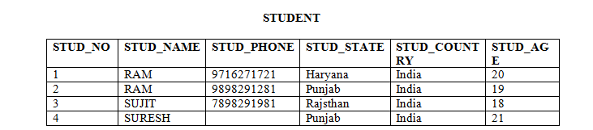
Functional Dependency
Possible FDs
STUD_NO is unique for each student
STUD_NO → STUD_NAME
STUD_NO → STUD_PHONE
STUD_NO → STUD_STATE
STUD_NO → STUD_COUNTRY
STUD_NO → STUD_AGE
STUD_STATE → STUD_COUNTRY
Check FD: STUD_STATE → STUD_COUNTRY ?
Yes, possible FD, as if two records have same STUD_STATE, they will have same STUD_COUNTRY as well
Check FD: STUD_NAME → STUD_ADDR ?
No, Not possible, as two students’ having same name, determines two different States.

Slide 26
Functional Dependency
FDs set: Set of all FDs present in the relation
{STUD_NO → STUD_NAME,
STUD_NO → STUD_PHONE
STUD_NO → STUD_STATE
STUD_NO → STUD_COUNTRY
STUD_NO → STUD_AGE
STUD_STATE → STUD_COUNTRY
}

Slide 27
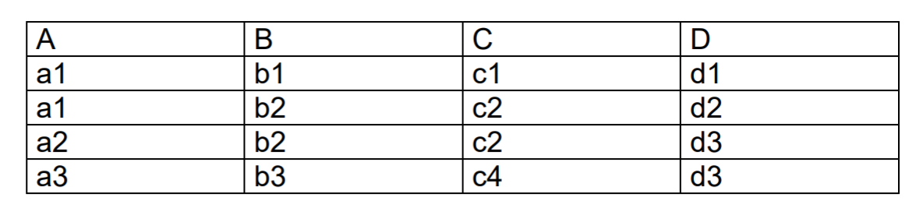
Functional Dependency
FD Set: ?
{
C→B
AB→C
AB→D
CD→B
}
Check FDs?
A→B
(Violating Tuples: 1 and 2)
B→A
(Violating Tuples: 2 and 3)
D→C
(Violating Tuples: 3 and 4)

Slide 28
Functional Dependencies (FDs)
A functional dependency is trivial if it is satisfied by all instances of a relation
Example:
ID, name → ID
name → name
In general, α → β is trivial if β ⊆ α
Although trivial Fds are valid, they offer no additional information about integrity constraints for the relation
As far as normalization is concerned, trivial Fds are ignored

Slide 29
Closure of a Set of Functional Dependencies
Given a set F of functional dependencies, there are certain other functional dependencies that are logically implied by F which can be inferred or deduced from the Fds in F
For example: If we know that Kristi is older than Debi and that Debi is older than Traci, we are able to infer that Kristi is older than Traci.
How did we make this inference?
Without thinking about it or maybe knowing about it, we utilized a transitivity rule to make this inference: Kristi > Debi, Debi > Traci, then Kristi > Traci

Slide 30
Closure of a Set of Functional Dependencies
For example: If A → B and B → C, then we can infer that A → C
The set of all functional dependencies logically implied by F is the closure of F
We denote the closure of F by F⁺
F⁺ is a superset of F

Slide 31
Closure of a Set of Functional Dependencies
To infer {A → C} from {{A → B}, {B → C}}
Require a set of inference rules to infer the set of Fds in F+
Armstrong provided a set of inference rules

Slide 32
Closure of a Set of Functional Dependencies
We can find F^{+,} the closure of F, by repeatedly applying Armstrong’s Axioms:
Main (sufficient set of inference rules for generating closure set of FDs)
if β ⊆ α, then α → β (Reflexivity)
if α → β, then γ α → γ β (Augmentation)
if α → β, and β → γ, then α → γ (Transitivity)
Others (Can be derived from main)
if α → γ β , then α → γ and α → β (Projection)
if α → γ and α → β, then α → γ β (Additive)
if α → β, and β γ→ l, then αγ → l (Pseudo Transitivity)
These rules are
sound (generate only functional dependencies that actually hold), and
complete (generate all functional dependencies that hold)

Slide 33
Closure of a Set of Functional Dependencies
R = (A, B, C, G, H, I) F = { A → B A → C CG → H CG → I B → H}
Some members of F⁺ : {A → H, AG → I} ?
A → H
Achieved by:
1) transitivity from A → B
2) transitivity from B → H

Slide 34
Closure of a Set of Functional Dependencies
R = (A, B, C, G, H, I) F = { A → B A → C CG → H CG → I B → H}
Some members of F⁺ : {A → H, AG → I} ?
AG → I
Achieved by
1) augmenting A → C with G, to get AG → CG
2) transitivity with CG → I

Slide 35
Closure of a Set of Functional Dependencies
Given R = (A,B,C,D,E,F,G,H, I, J) and
F = {AB → E, AG → J, BE → I, E → G, GI → H}
Does F+ : {AB → GH} ?

Slide 36
Closure of a Set of FDs
if β ⊆ α, then α → β (Reflexivity)
if α → β, then γ α → γ β (Augmentation)
if α → β, and β → γ, then α → γ (Transitivity)
if α → γ β , then α → γ and α → β (Projection)
if α → γ and α → β, then α → γ β (Additive)
Given R = (A,B,C,D,E,F,G,H, I, J) and F = {AB → E, AG → J, BE → I, E → G, GI → H}, Does F+: {AB → GH}?
Proof
1. AB → E, given in F
2. AB → AB, reflexive rule IR1
3. AB → B, projective rule IR4 from step 2
4. AB → BE, additive rule IR5 from steps 1 and 3
5. BE → I, given in F
6. AB → I, transitive rule IR3 from steps 4 and 5
7. E → G, given in F
8. AB → G, transitive rule IR3 from steps 1 and 7
9. AB → GI, additive rule IR5 from steps 6 and 8
10. GI → H, given in F
11. AB → H, transitive rule IR3 from steps 9 and 10
12. AB → GH, additive rule IR5 from steps 8 and 11
– proven

Slide 37
Procedure for Computing F⁺
To compute the closure of a set of functional dependencies F:
F ⁺ = F repeat for each functional dependency f in F⁺ apply reflexivity and augmentation rules on f add the resulting functional dependencies to F ⁺ for each pair of functional dependencies f₁and f₂ in F ⁺ if f₁ and f₂ can be combined using transitivity then add the resulting functional dependency to F ⁺ until F ⁺ does not change any further
NOTE: We shall see an alternative procedure for this task later

Slide 38
Hardware Company Database
Salesperson is working at an office. Salesperson sells the products to the customers.

Slide 39
Hardware Company: SALESPERSON and PRODUCT
List out the functional dependencies.

Slide 40
Hardware Company: SALESPERSON and PRODUCT

Slide 41
Functional Dependency - Advantages
Removes data redundancy where the same values should not be repeated at multiple locations in the same database table
Maintains the quality of data in the database
Allows clearly defined meanings and constraints of databases
Helps in identifying bad designs of the database
Expresses the facts about the database design

Slide 42
Attributes Closure
An attribute B is functionally determined by α, if α → B
To test whether a set α is a super key
Devise an algorithm for computing the set of attributes functionally determined by α
Using FDs
One way of doing this is to compute F⁺, take all functional dependencies with as the left-hand side, and take the union of the right-hand sides of all such dependencies
Expensive, since F⁺ can be large
Solution
Attributes Set Closure

Slide 43
Uses of Attributes Set Closure
Testing for super key:
To test if α is a super key, compute α^{+,} and check if α⁺ contains all attributes of R
Testing functional dependencies
To check if a functional dependency α → β holds (or, in other words, is in F⁺), just check if β ⊆ α⁺
Compute α⁺ by using attribute closure, and then check if it contains β
Is a simple and cheap test, and very useful
Computing closure of F
For each γ ⊆ R, find the closure γ⁺, and for each S ⊆ γ⁺, output a functional dependency γ → S

Slide 44
Closure of Attribute Sets
Given a set of attributes α, define the closure of α under F (denoted by α⁺) as the set of attributes that are functionally determined by α under F
Algorithm to compute α⁺, the closure of α under F result := α; while (changes to result) do for each β → γ in F do begin if β ⊆ result then result := result ∪ γ end

Slide 45
Example of Attribute Set Closure
R = (A, B, C, G, H, I)
F = {A → B, A → C, CG → H, CG → I, B → H}
(AG)⁺ = ?
1. result = AG
2. result = ABCG (A → B and A ⊆ AG, so result U= B,
A → C and A ⊆ AG, so result U= C)
3. result = ABCGH (CG → H and CG ⊆ AGBC, so result U= H)
result = ABCGHI (CG → I and CG ⊆ AGBCH, so result U= I)
No new attributes are added to result after this, and the algorithm terminates

Slide 46
Uses of the Attribute Closure
To test if α is a superkey, we compute α+, and check if α+ contains all attributes in R
We can check if a functional dependency α → β holds (or, in other words, is in F+), by checking if β ⊆ α+. That is, we compute α+ by using attribute closure, and then check if it contains β
It gives us an alternative way to compute F+: For each γ⊆ R, we find the closuer γ+ and for each S ⊆ γ +, we output a functional dependency γ → S.

Slide 47
Attribute Set Closure
FDs set:{
STUD_NO → STUD_NAME,
STUD_NO → STUD_PHONE
STUD_NO → STUD_STATE
STUD_NO → STUD_COUNTRY
STUD_NO → STUD_AGE
STUD_STATE → STUD_COUNTRY
}
Attribute Closure:
(STUD_NO)+ = {
STUD_NO,
STUD_NAME,
STUD_PHONE,
STUD_STATE,
STUD_COUNTRY,
STUD_AGE
}
(STUD_STATE)+ = {STUD_STATE, STUD_COUNTRY}

Slide 48
Find Candidate Keys and Super Keys using Attribute Closure
If attribute closure of an attribute set contains all attributes of relation, the attribute set will be super key of the relation
If no subset of this attribute set can functionally determine all attributes of the relation, the set will be candidate key as well
For Example, using FD set of STUDENT table ,
(STUD_NO, STUD_NAME)+ =
{STUD_NO, STUD_NAME, STUD_PHONE, STUD_STATE, STUD_COUNTRY, STUD_AGE}
(STUD_NO)+ =
{STUD_NO, STUD_NAME, STUD_PHONE, STUD_STATE, STUD_COUNTRY, STUD_AGE}
(STUD_NO, STUD_NAME) will be super key but not candidate key because its subset (STUD_NO)+ is equal to all attributes of the relation
So, STUD_NO will be a candidate key

Slide 49
Example of Attribute Set Closure
Let R= (A, B, C, D, E, F) be a relation scheme with the following dependencies: C->F, E->A, EC->D, A->B. Which of the following is a key for R?
(a) CD (b) EC
(c) AE (d) AC
FDs: C->F, E->A, EC->D, A->B Find closure set for CD. X = CD = CDF {C->F}
No more attributes can be added to X. Hence closure set of CD = CDF
Find closure set for EC. X = EC = ECF {C->F} = ECFA {E->A} = ECFAD {EC->D} = ECFADB {A->B}
Closure set of EC covers all the attributes of the relation R.
If any closure covers all the attributes of the relation R then that is the key.

Slide 50
Attribute Closure
Given the relation scheme R = {E, F, G, H, I, J, K, L, M, M} and the set of functional dependencies {{E, F} -> {G}, {F} -> {I, J}, {E, H} -> {K, L}, K -> {M}, L -> {N} on R.
What is the key for R?: i) {E, F}, ii) {E, F, H}, iii) {E, F, H, K, L}, iv) {E}

